Slide 1
Welcome to the Cathedral Pines Metro District Board’s Second Annual Resident Meeting!
February 21, 2023

Slide 2
Agenda
Introductions
Current Metro District Board Members and Guests
Who Does What?
Metro/HOA/El Paso County
Board Accomplishments in 2022 by Area of Responsibility
Board Objectives for 2023
Long Term Strategic Issues for Community
Nearby Community Update
Board Member Openings/Election Process
Financial Report
Open Forum
Adjournment

Slide 3
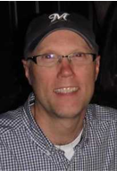
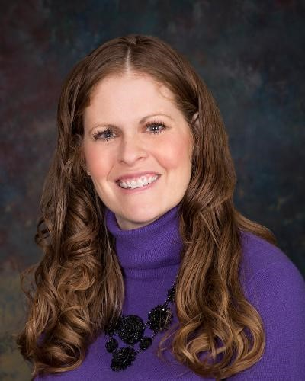
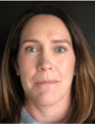
Metro District Board of Directors 2022/23
Bill Heeter - President (May 2023)
Rick Stauch- Vice President (May 2025)
Debbie Perry -Treasurer (May 2025)
Ecton Espenlaub - Secretary (May 2025)
Lynn Shepherd – At Large (May 2023)
(Dates in parentheses show year of term expiration)

Slide 4
Metro District Board of Directors 2022/23
Primary Areas of Responsibility
Bill Heeter – General Board Management, Landscaping, Newsletter, Special Projects
Rick Stauch – Joint Community Engagement Committee, Special Projects
Debbie Perry –Financial Reporting, Bonds, Payables
Ecton Espenlaub – Trails, General Maintenance
Lynn Shepherd – Lodge Operations

Slide 5
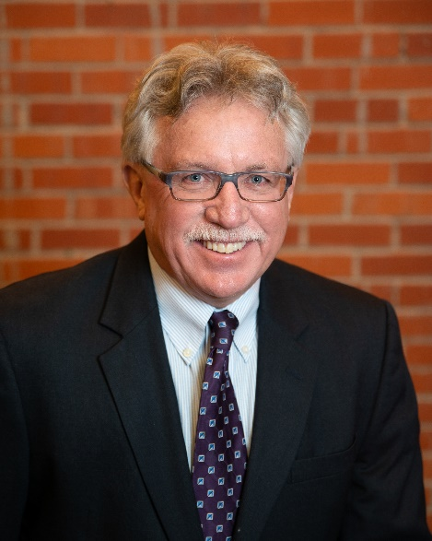
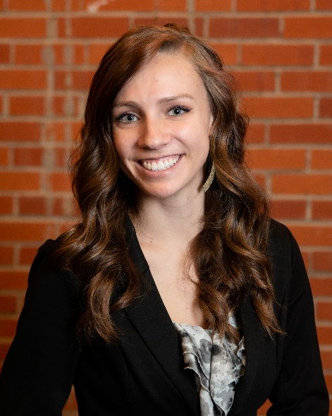
The Walker-Schooler District Management Team
Primary Responsibilities
Public Reporting: Agendas, Minutes, Meeting Dates, Board Resolutions
Governmental Policy Guidance and Reporting
Legal Liaison
Budgeting and Financial Reporting, including External Audit Management
Assistance with all Agreements, RFPs and Grant Applications
Accounting and Bookkeeping services
Official Custodian of Records
New 2023 added Responsibilities
Day-to-day Community Operations (Landscaping, Repairs & Maintenance)
Communications with Service Providers, Lodge Management
Project Execution and Follow-up
Kevin Walker
President of WSDM
Rebecca Harris
District Manager
WSDM - Contact Information​
Phone: 719-447-1777​
Email: Rebecca.H@wsdistricts.co​
Website: wsdistricts.co

Slide 6
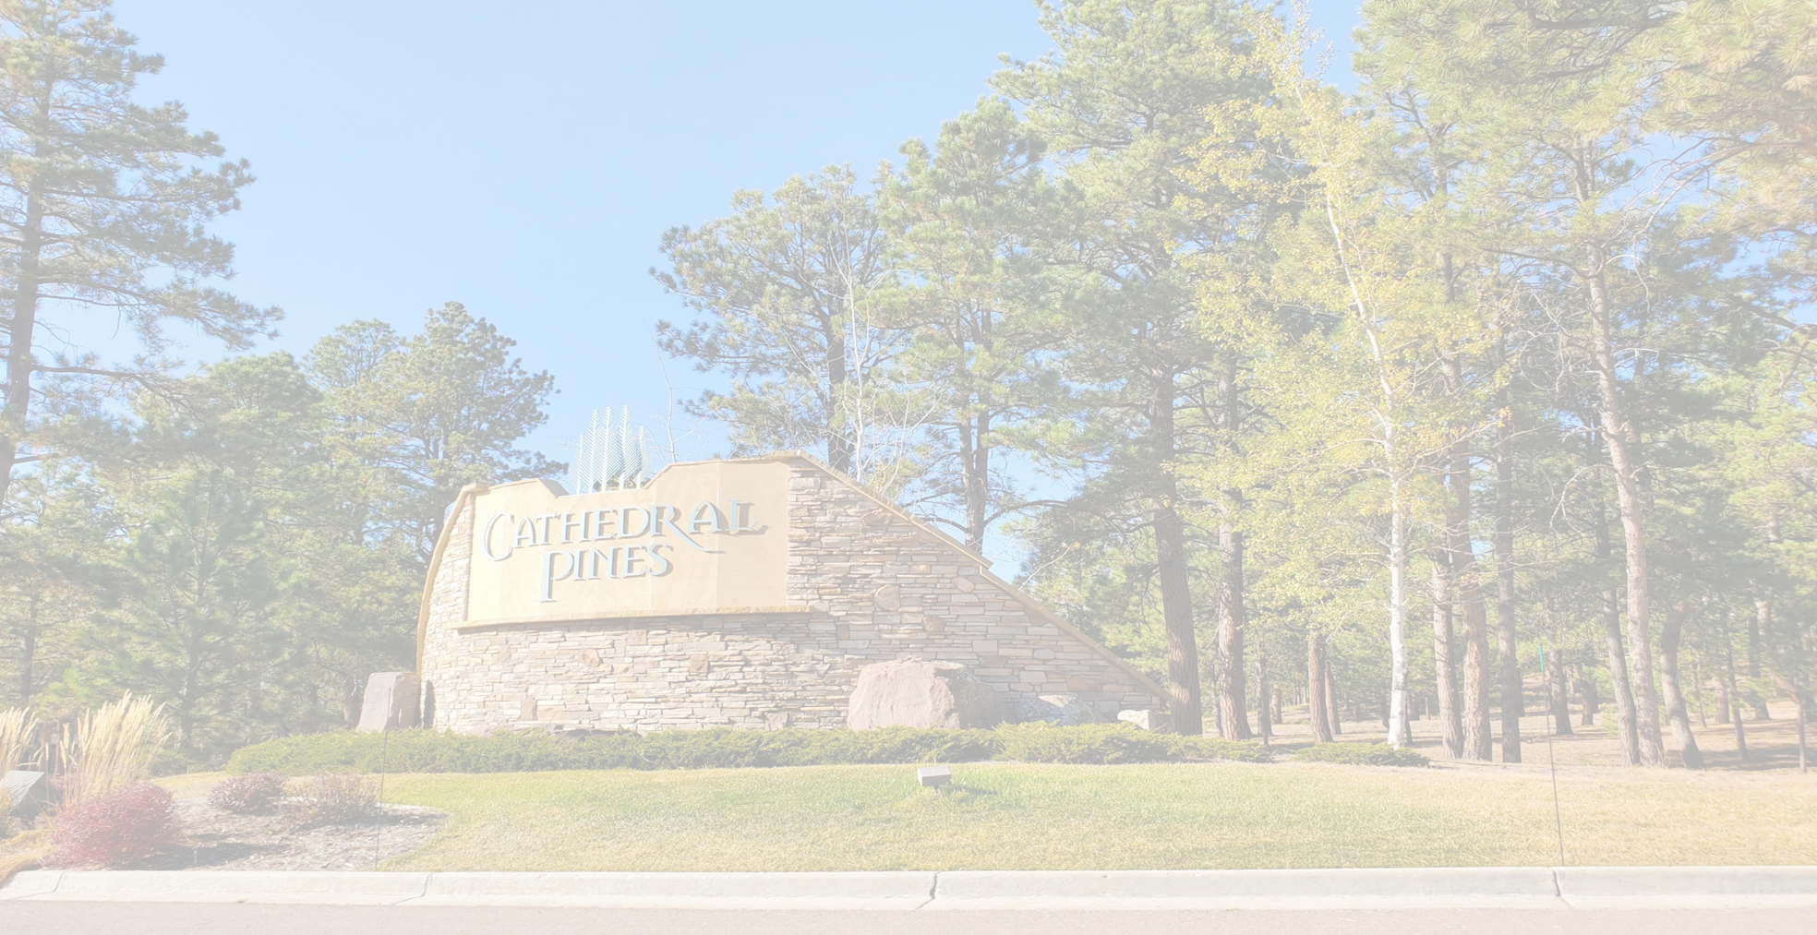
Who Does What? Metro District Services Include:
Operations and maintenance of the common areas, landscaping, medians, ponds, trails (in conjunction with El Paso County), mailbox area, and Vessey storage shed
Lodge Operations; interior and exterior maintenance including landscaping, parking, and snow removal; Lodge rentals, financial performance and capital improvements
Repayment of bonds for initial infrastructure and improvements with property tax revenue
Secondary responsibility for snow removal on Cathedral Pines (first pass)
Metro District budget management and bill payment
Manage insurances for Property & Liability, as well as Board of Directors coverage
All Metro District tasks consolidated under WSDM – District Managers effective this January 1, improving communication and reducing management costs
cathedralpines.colorado.gov

Slide 7
Who Does What? Homeowners Association Services Include:
Community Activities, including Social, Forestry Health, and Conducting Annual Homeowners Association Meeting
HOA Budget Management/Assessment Collection
Invoice verification/monthly financial reporting
Trash Collection Management
Community Governance/Covenant Resolution
Fine/Lien Authority
Architectural Control Committee
Water Augmentation Plan Monitoring, including collection of well readings for the State Water District
(Due annually each October 31st)
Insurance for Liability, Directors & Officers; and Property for Monuments
portal.warrenmgmt.com

Slide 8
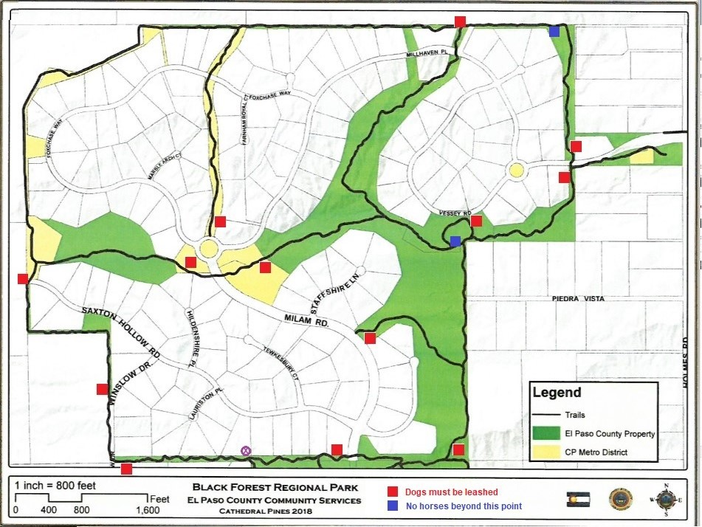
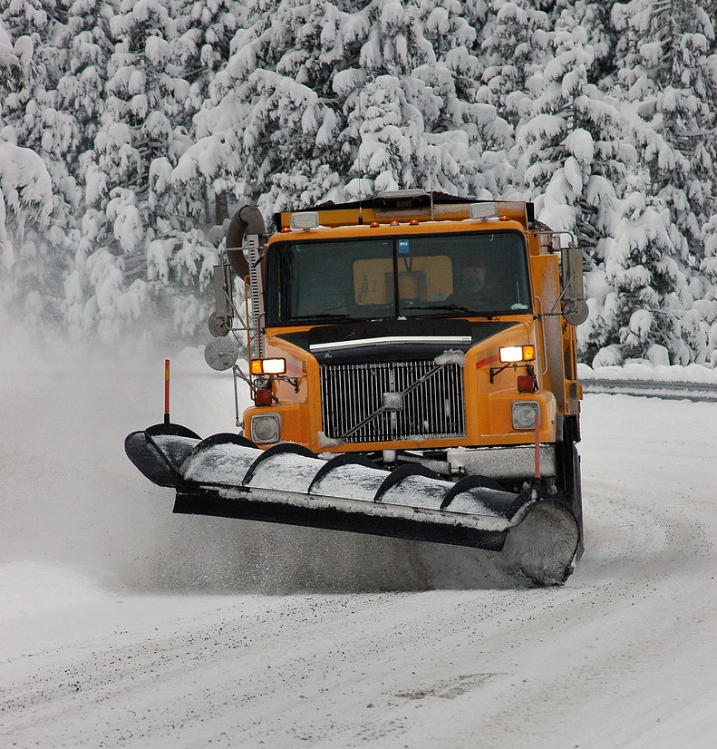
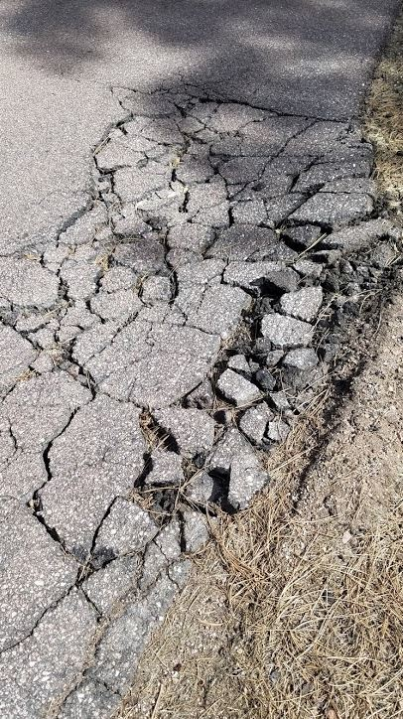
Who Does What?
El Paso County is responsible for:
Roads – Repairs and Maintenance
Curbs/Gutters- Repairs and Maintenance
Trail System Repairs and Maintenance (in conjunction with Metro District)
Weed Control Along Right of Ways
Drainage Along Right of Ways
Primary Responsibility for Snow Removal on CP roads
Weed Control on County Properties
citizenconnect.elpasoco.com

Slide 9
2022 Metro District Accomplishments
Landscaping
Expanded areas of mowing
Roadsides
Lower Vessey Pond Area
NE area adjacent to Flying Horse North
Development of Long-Term Landscaping Plan approved by residents in Spring survey
Based upon community survey, developed irrigation system replacement plan; solicited bids and vetted contractors
Roundabouts clean-up
Assumption of full responsibility for both Spring & Fall chipping program
Winslow entrance clean-up
Tree trimming along Milam Road

Slide 10
2023 Metro District Objectives
Landscaping
Implement first phase of long-term landscaping plan per Spring 2022 resident survey
Award contract for replacing Milam irrigation; oversee completion of project
Replace shrubs on Milam with native, less water-dependent varieties
Develop roadside seedling mitigation program
Continue sponsorship of semi-annual chipping program
Develop mistletoe abatement program
Assume management of all three entrance monuments from HOA

Slide 11
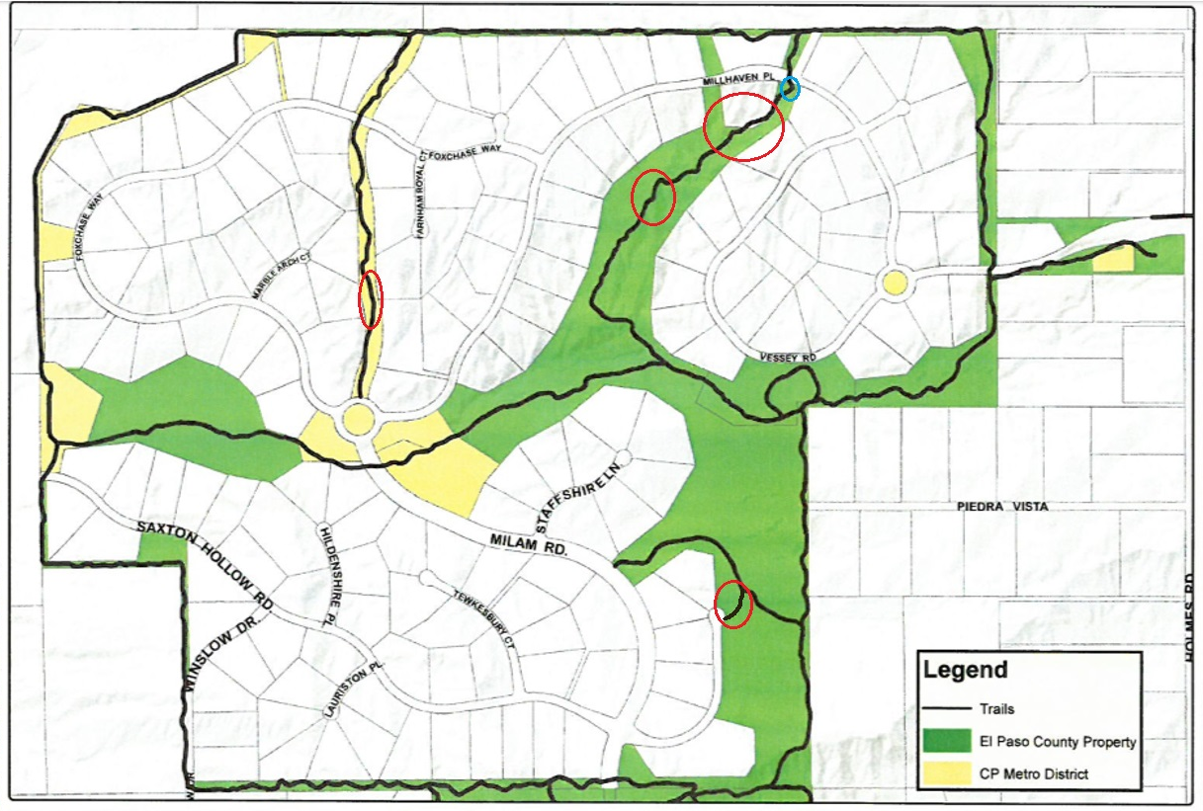
2022 Metro District Accomplishments
Trails and Maintenance
Three re-routes on interior trails
Created a new connecting trail from
Saxton Hollow East
Weed Reduction north of Vessey
Removed dead trees
Repaired inflow of water to lower Milam pond to restore water levels

Slide 12
2023 Metro District Objectives
Trails and Maintenance
Erosion repair south of Millhaven
Erosion and weather maintenance
Remove cattails from the top of the north water feature
Repair lower Milam pond liner
Remove dead trees near the barn

Slide 13
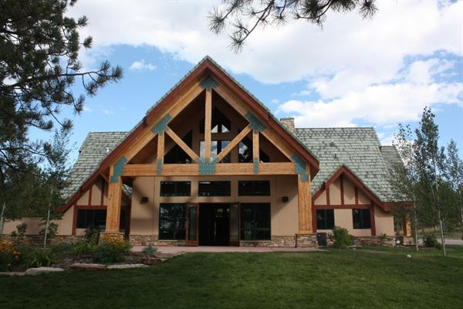
2023 Metro District Accomplishments
Lodge Operations
Interviewed and hired new Lodge Management Company (VenQ) in February ‘22
Conducted mid-year open house for suppliers, renters
Developed marketing plan for 2023 implementation
Held late-year open house for Colorado Springs Chamber of Commerce
Causes of bookings shortfall vs. budget;
Management change early in year
Transition out of COVID
Bookings take place year in advance
(result of 2022 bookings seen in 2023)
Phone communications issues
(continued)

Slide 14
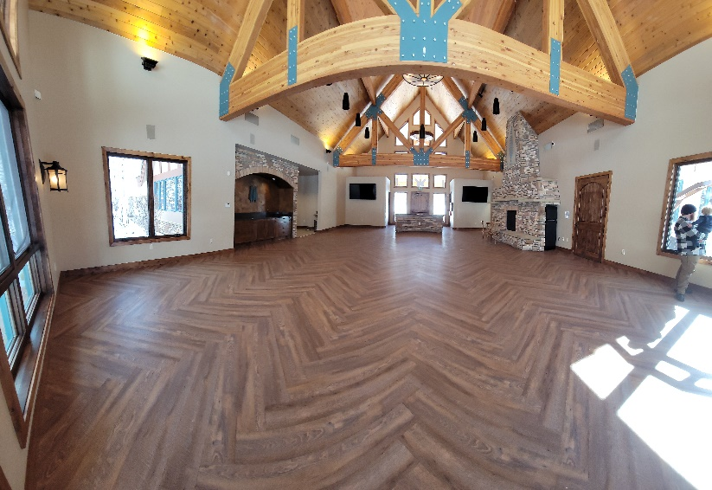
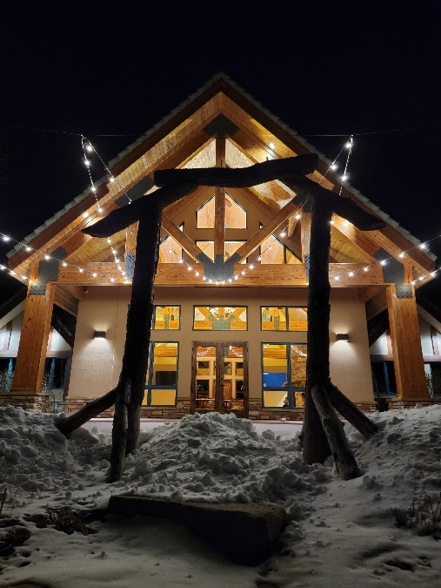
2022 Metro District Accomplishments
Lodge Improvements
Replaced flooring
Resealed exterior wood
Removed entrance wall; installed new countertop
Installed patio lights on rear patio
Purchased new chairs to replace plastic
Replaced broken ice machine with like-new
Replaced security and fire alarm systems
Upgraded audio system within Lodge
Sold kitchen appliances and plastic chairs; proceeds returned to budget

Slide 15
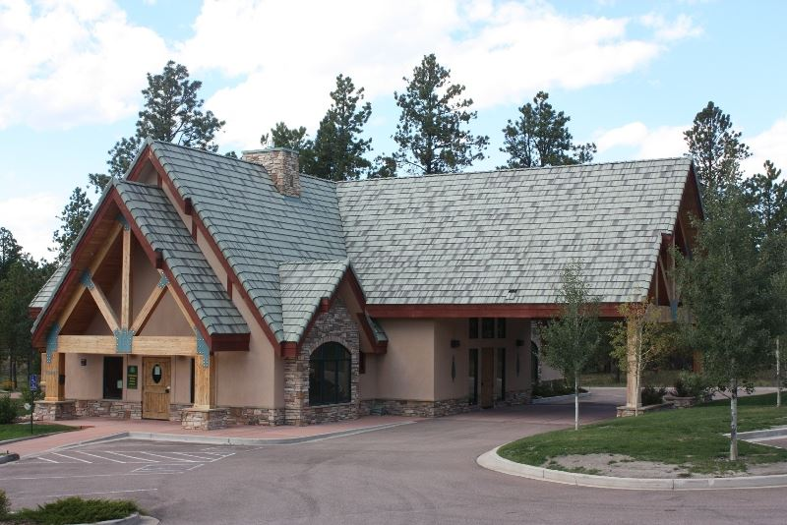
2022 Lodge Community Usage Recap*
Metro Board Meetings 10
Support for HOA Events:
HOA Governance Meetings 11
HOA/ACC Board Meetings 18
Joint Comm. Engagement 5
HOA Poker Night 5
HOA Bunko 7
HOA Family Movie Night 1
Recycling Event 1
Trick or Treat Event 1
Resident Private Events 15
Resident-Sponsored Comm. Events 4

Slide 16
2023 Metro District Objectives
Lodge Operational Objectives
Develop New Lodge Management Plan; division of responsibilities:
Bookings Manager
Hire External Professional Marketing Company
Implement Management Improvement Plan
Expand Marketing Plan to Include Business/Retreats
Complete installation of new audio system on rear deck (noise suppressed for neighbors)
Install seasonal decorations to coordinate with
HOA

Slide 17
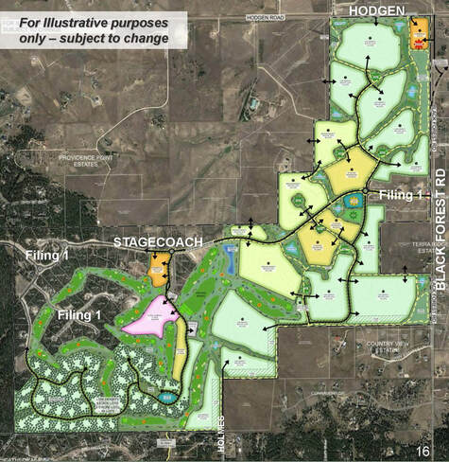
2022 Metro District Accomplishments
Nearby Community Issues
Flying Horse North
Approved sketch plan
Average density of 0.9 acres per residence
225 Room luxury hotel with 50 golf casitas/flats
Communication and Representation Before County
Planning Commission Presentation
Board of County Commissioners Presentation
Adjacent Community Meetings
Monitored development of The Estates at Cathedral Pines
Flying Horse North
Cathedral Pines Metropolitan District

Slide 18
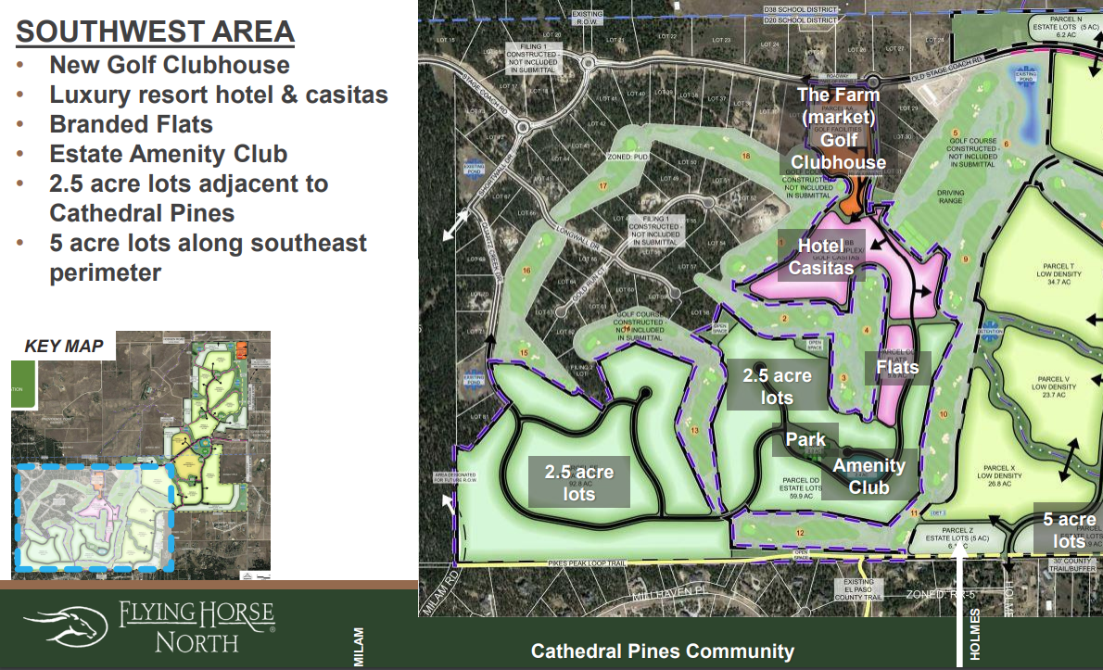
2023 Metro District Objectives
Continue to Advocate Responsible Development of Flying Horse North
Provide opposing presentations at all future county hearings
Continue to press for average density of 2.5 acres per house
Responsible use of water resources
Adequate traffic controls
Estates at Cathedral Pines
35 Acre parcel west of Winslow, south of Saxton Hollow
Total of 8 lots, each 4.25 acres
Average size of homes between 6,500 sf – 10,000 sf
Prices between $4 - $7 Million, including lot and full landscape package
Gifting easement on east side of development to continue Black Forest Regional Trail System
Presale of lots to begin in the next 60 days
Ground-breaking for infrastructure as early as June 2023
Presented at their September 2022 Presentation
https://www.flyinghorsecolorado.com/uploads/1/0/5/2/105273605/neighborhood_meeting-9-8-22_final.pdf

Slide 19
Long Term Strategic Issues for Our Community
Major Issues Facing the Community
Lack of investment in environment and aesthetics to maintain upscale environment
Implications of irrigation system failure
Deterioration of ponds on lower Vessey from original condition
Road conditions deteriorating
Impact of traffic changes due to nearby developments/effects on entrances into community
Key Question: What do we want our community to look like
10-20 years from now?

Slide 20
Long Term Strategic Issues for Our Community
The Process
Preliminary Landscape Design Plan options presented at 2022 Annual Meeting for community feedback and voted upon by residents in Spring 2022 survey
Options presented included areas of primary focus, projects to be pursued, and what type of landscaping design (i.e., “green,” hybrid, or xeric) was desired for future landscape implementation
Electronic survey designed and executed by Landscape Design Consultants Kimley-Horn

Slide 21
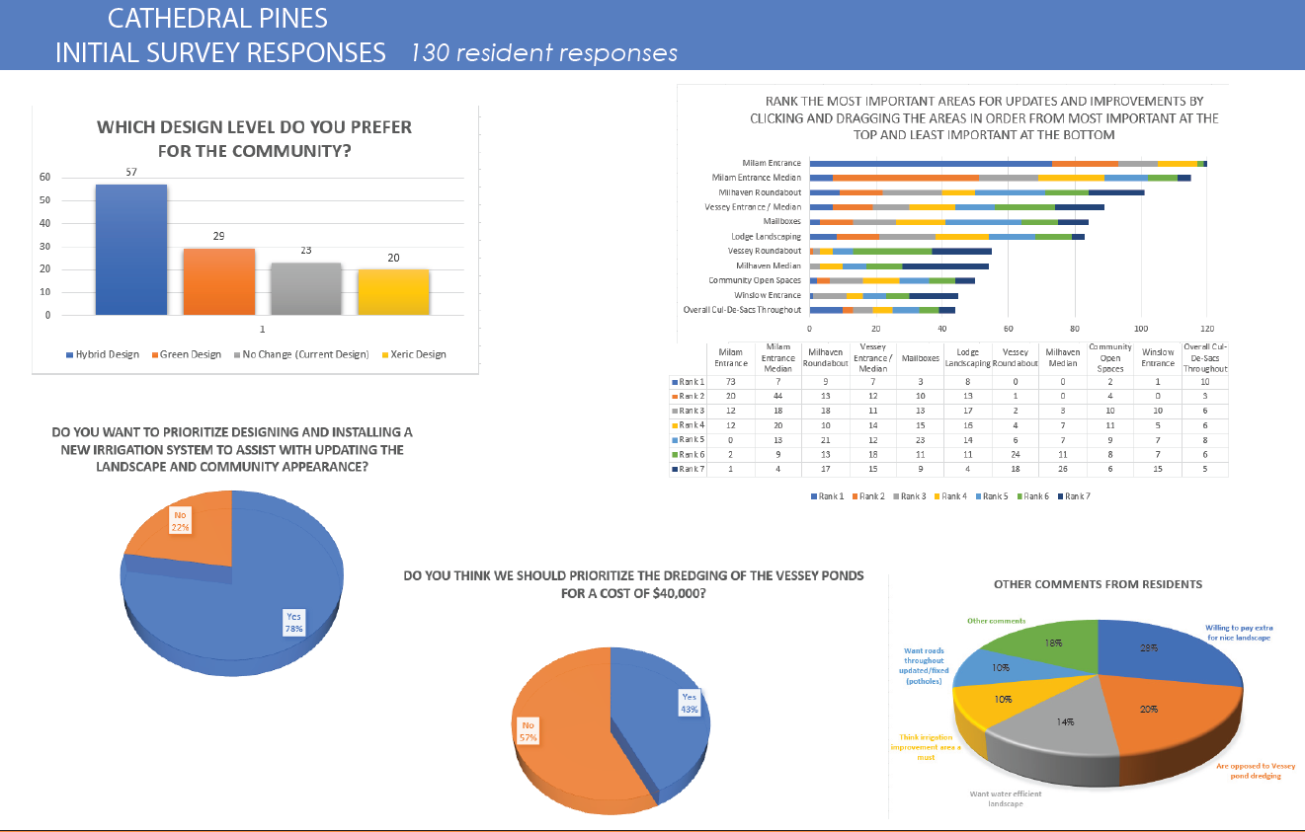
Survey Conclusions

Slide 24
Long Term Strategic Issues for Our Community
Status of Irrigation System Update
Technical Specifications developed and RFPs sent September 2022 to 7 potential bidders with November 1 deadline for submission
As of November 1, 2022 only 2 bids received
Bidding period extended through February 15, 2023, with 3 additional contractors solicited (10 in total)
No additional bids received due to:
Complexity of project
Lack of labor force to execute
Prior commitments to other major projects
Two viable bidders considered by Board
$200,000 allocated for project in 2023 approved budget
Metro Board has applied for $25,000 State grant to facilitate replacement; decision on grant to be made in April 2023

Slide 25
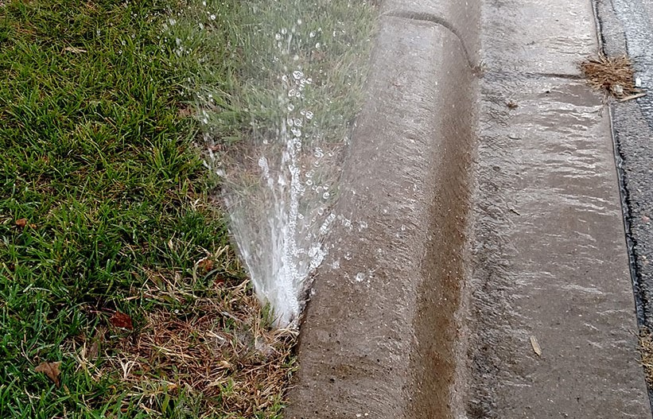
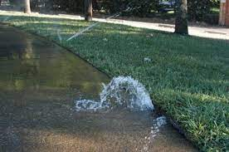
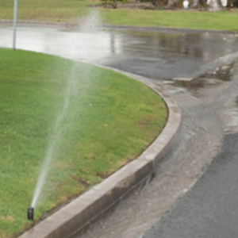
Long Term Strategic Issues for Our Community
Benefits of Replacing Current Irrigation System
Current system has frequent leaks/breakdowns, inefficiently uses water and does not adequately support planted growth
Reduces ever-increasing repair costs
New system maintains green entry into community
Much more efficient technology now available
Wind/rainfall sensors adjust watering levels
Centrally programmable
Modular; can be expanded for future needs
Replaces broken underground lines

Slide 26
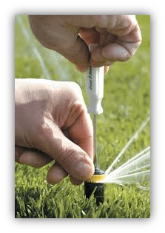
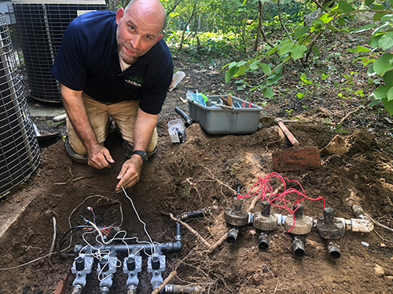
Long Term Strategic Issues for Our Community
Cost of Replacing Current System
Existing system will be completely abandoned
Projected Project Cost: $200,000-$250,000
Contractor To Be Selected By March 20
Start Date: May 2023 (depending upon weather)
Anticipated Completion Date: August 2023
Financing: None required
Objective: No additional fees, borrowing or assessments required to replace system

Slide 27
2023 Metro District Election Process - – Rebecca Harris (Walker-Schooler)
Metro Board Openings in 2023
Due to changes in State Election Laws and a move to rotating terms, 2 CP Metro District Board seats are open for election this May for 4-yr. terms
Self-nomination forms are available online at https://cathedralpinesmd.colorado.gov/elections-0
Important Deadline:
Self-Nomination forms are due February 24, 2023
Write-in Candidate Deadline is February 27, 2023, by 5:00pm
Notice of Cancellation (if applicable) is February 28, 2023
Election (if applicable) is May 2, 2023
Election Process overseen by Teak Simonton, our Designated Election Official (DEO)
Requirements to run for Metro District Board Seat are (defined as Eligible Elector):
Registered to Vote in Colorado AND either;
Resident of the District, or
The owner (or spouse of the owner) of taxable real or personal property situated in the District
Non-compensated position
Normally requires 15-20 hr. commitment/month
Current Status of Election:
Self Nominations received: 4
Seats up for Election: 2

Slide 28
2023 Metro District Election Process – Rebecca Harris
Cost of an Election:
If the same number of nominations are received for the number of seats available, the Election can be cancelled, and those Nominees are elected to the open seats at the May Board meeting
If more nominations are received than seats available, the Election will be held May 2, 2023 via El Paso County mail-in ballots sent to all registered voters in community
Based upon election results, the two candidates receiving the highest number of votes will be seated at the May Metro Board meeting
An election cost for Cathedral Pines Metro District are estimated to be $25,000-30,000 to compensate required Designated Election Official and judges, necessary legal counsel guidance, and materials to hold an election (ballots, postage, etc.)
Cathedral Pines has included the anticipated cost in the adopted 2023 budget

Slide 29
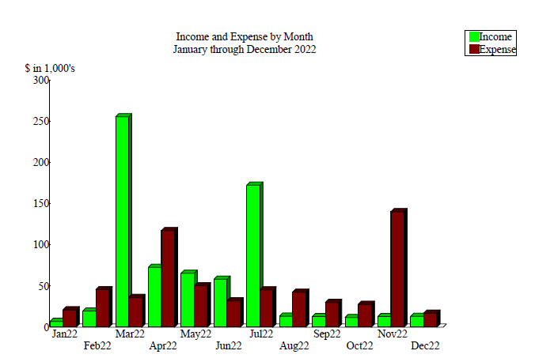
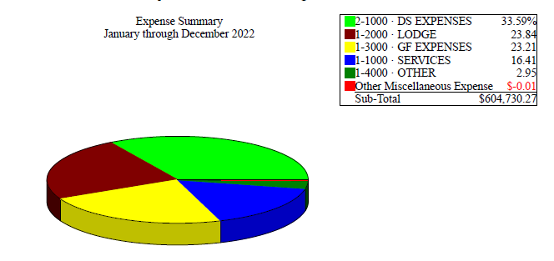
2022 Metro District Accomplishments
Financial Performance
Minimize impact of unexpected expenses
Board Election
Irrigation System Breakdowns
Manage shortfall in projected Lodge rentals by reducing expenses
Continue to build Contingency and Reserve Funds
Fund Lodge improvements through operating budget
Maintain Mill Levy
Pursue FEMA Claim

Slide 30
*Unaudited Financials
 | 2022 Approved Budget | 2022 Actuals | 2023 Approved Budget
General Fund Revenue
Property Taxes | 292,867 | 292,867 | 288,218
Lodge Rentals | 75,000 | 52,000 | 115,000
FEMA Funds | 20,000 | 0 | 20,000
Other Revenue | 50,998 | 61,563 | 50,551
Total Revenue | 438,865 | 406,430 | 473,769
General Fund Expenses
Professional Services | 106,555 | 94,545 | 105,215
Lodge Operations | 177,800 | 156,418 | 114,000
Management | 42,000 | 63,357 | 34,500
Capital Improvements | 60,000 | 43,459 | 5,000
 | (continued)

Slide 31
*Unaudited Financials
 | 2022 Approved Budget | 2022 Actuals | 2023 Approved Budget
General Fund Expenses (con’t)
Landscape Maintenance | 45,000 | 54,631 | 50,000
Repairs and Maintenance | 25,000 | 28,000 | 30,000
Irrigation System Replacement | - | - | 200,000
Board Election | 10,000 | 28,800 | 25,000
Other Expenses | 81,393 | 44,346 | 66,323
Total General Fund Expenses | 445,748 | 406,740 | 590,538
Capital Reserve Cont. | 25,000 | 50,000 | 50,000
General Fund Beg. Balance | 282,139 | 270,240 | 219,929
General Fund Ending Balance | 250,256 | 219,929 | 53,160

Slide 32
*Unaudited Financials
 | 2022 Approved Budget | 2022 Actuals | 2023 Approved Budget
Debt Service Fund Beg. Balance | 184,780 | 122,635 | 123,427
Debt Service Fund Revenue | 292,867 | 296,940 | 289,718
Debt Service Expenditures | 297,650 | 296,148 | 298,473
Debt Service Ending Balance | 179,997 | 123,427 | 114,672
Assessed Valuation | 15,414,060 | 15,414,060 | 15,169,380
Mill Levy | 19.0 | 19.0 | 19.0

Slide 33
2023 Metro Board Financial Objectives
Financial Objectives
Improve financial performance of Lodge
Explore Special District Infrastructure Grants (part of HB 22-1151)
Maintain Mill Levy for 2023
Fully fund irrigation system replacement out of operating funds
Manage Capital Spending plan
Collect outstanding FEMA Claim (+/- $50,000)
Continue to strengthen Contingency and Reserve funds

Slide 34
Conclusion
This Board’s goal is to make decisions that it feels are in the best interest of the community, based upon resident feedback, economic considerations, and additional research that guides those decisions
Are there areas of concern that you would like us to pursue that we are not?
Please sign up on our new Metro District e-mail list before leaving. You will receive our monthly newsletter, relevant Metro District announcements, and community surveys seeking your feedback

Slide 35
Questions and Answers with our Homeowners

