Slide 1
Welcome to the Cathedral Pines Metro District Board’s Third Annual Resident Meeting!
February 20, 2024

Slide 2
Agenda
Introductions
Current Metro District Board Members and Guests
Meeting Ground Rules
Who Does What?
Metro/HOA/El Paso County/USPS
Board Accomplishments in 2023 by Area of Responsibility
Board Objectives for 2024
Long Term Strategic Issues for Community
Nearby Community Update
Financial Report
Community Feedback on Proposed Initiatives
Open Forum
Adjournment

Slide 3
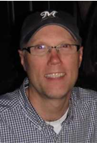
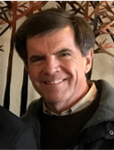
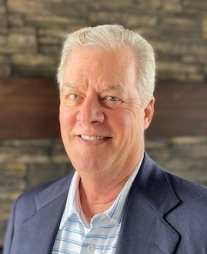
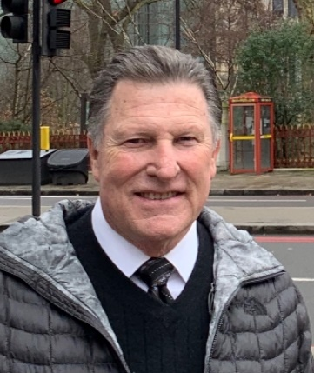
Metro District Board of Directors 2023-24
Bill Heeter - President (May 2027)
Rick Stauch- Vice President (May 2025)
Kevin Combs -Treasurer (May 2027)
Ecton Espenlaub - Secretary (May 2025)
Chris Meacham – Member At Large (May 2025)
(Dates in parentheses show year of term expiration)

Slide 4
Meeting Ground Rules
Please hold all questions until the end of presentation
Goal is to complete the presentation in 60-75 minutes
Please hold side conversations to a minimum
Board members will be available after the meeting to answer any additional questions
Just a reminder that all Board members are non-compensated volunteers
Meeting is being streamed Live for observation
Thanks for your cooperation!

Slide 5
Metro District Board of Directors 2023/24
Primary Areas of Responsibility
Bill Heeter – General Board Management, Lodge Operations, Newsletter, Special Projects
Rick Stauch – Joint Community Engagement Committee, Security Issues, Special Projects
Kevin Combs –Financial Reporting, Bonds, Payables
Ecton Espenlaub – Trails, Irrigation System Replacement Project, General Maintenance
Chris Meacham – As-Needed Projects

Slide 6
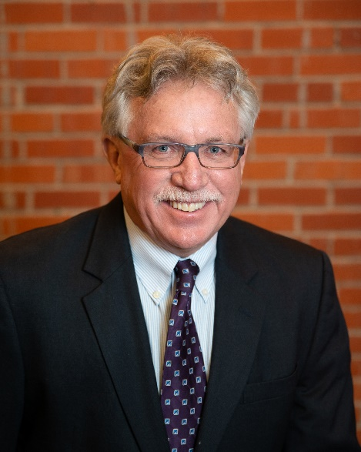
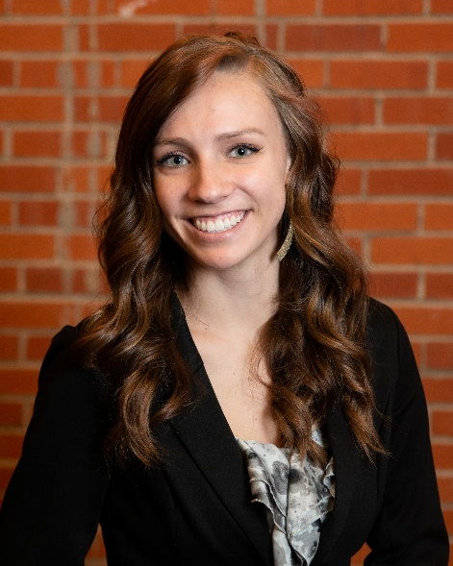
The WSDM - District Management Team
Primary Responsibilities
Public Reporting: Agendas, Minutes, Meeting Dates, Board Resolutions
Governmental Policy Guidance and Reporting
Legal Liaison
Budgeting and Financial Reporting, including External Audit Management
Assistance with all Contractual Agreements, RFPs and Grant Applications
Accounting and Bookkeeping services
Official Custodian of Records
Day-to-day Community Services/Operations
(Landscaping Contractors, Lodge Rentals, Repairs & Maintenance)
Special Project Execution and Follow-up (as assigned by Board)
Kevin Walker
President of WSDM
Rebecca Harris
District Manager
WSDM - Contact Information​
Phone: 719-447-1777​
Email: Rebecca.H@wsdistricts.co​
Website: wsdistricts.co

Slide 7
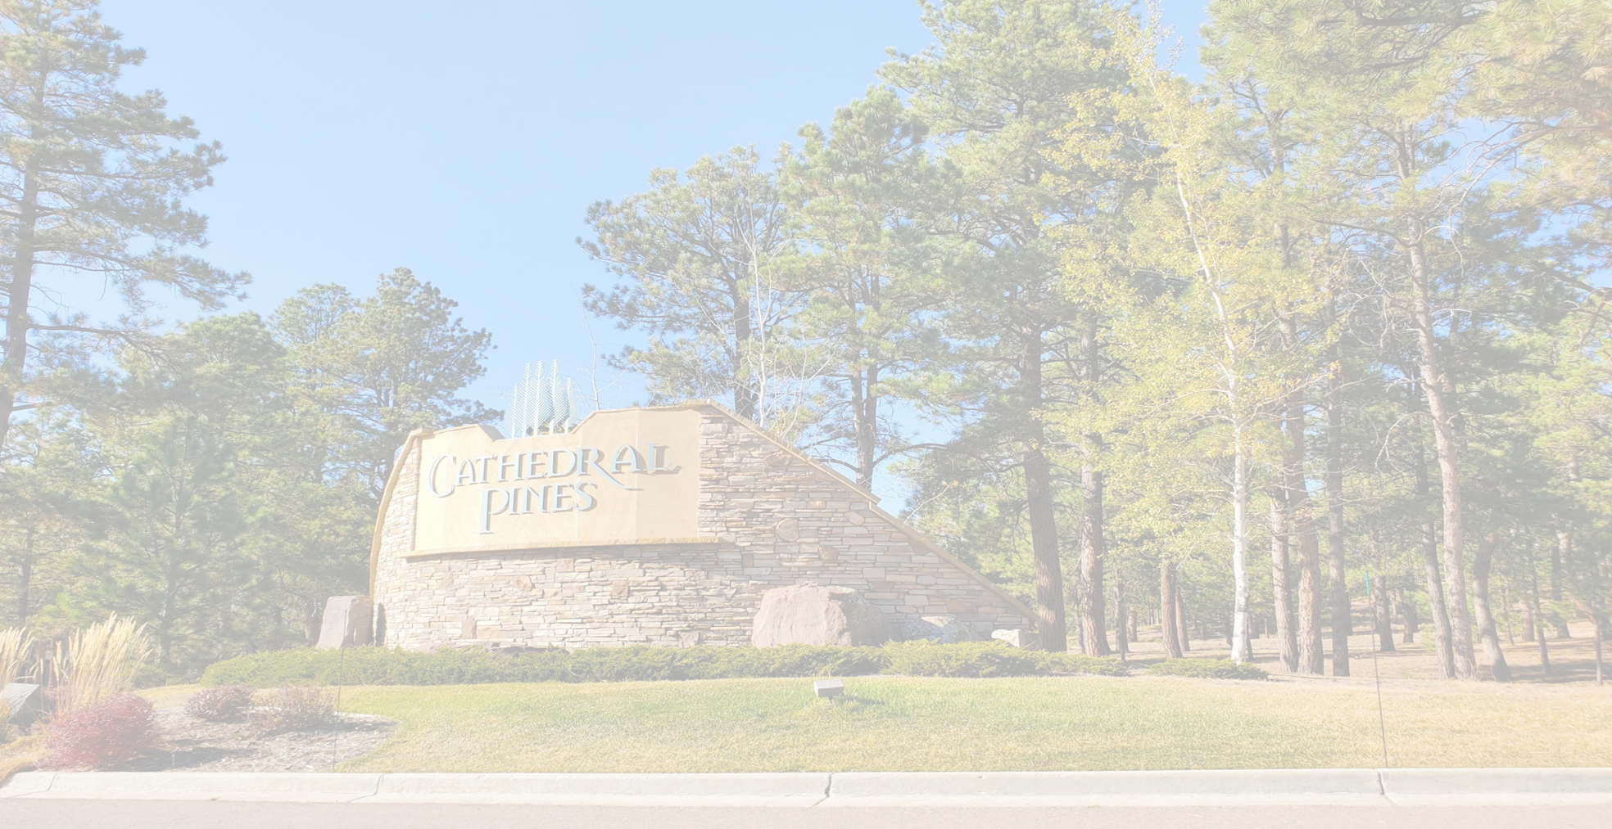
Who Does What? Metro District Services Include:
Maintenance of the common areas including Lodge grounds and open areas, general landscaping, medians, ponds, trails (in conjunction with El Paso County), mailbox area, and Vessey barn
Lodge Operations; interior and exterior maintenance including landscaping, parking lot and lights, and snow removal; Lodge rentals tracking and revenue collections, and financial performance
Repayment of bonds for initial infrastructure and improvements with property tax revenue
Secondary responsibility for snow removal on Cathedral Pines (first pass only)
Budget management and bill payment
Insurances for Property & Liability, as well as Board of Directors coverage
Mail Kiosk Security
cathedralpinesmd.colorado.gov

Slide 8
Who Does What? Homeowners Association Services Include:
Community Activities, including Social, Forestry Health, and Conducting Annual Homeowners Association Meeting
HOA Budget Management/Assessment Collection
Invoice verification/monthly financial reporting
Trash Collection Management
Community Governance/Covenant Resolution
Fine/Lien Authority
Architectural Control Committee
Water Augmentation Plan Monitoring, including collection of well readings for the State Water District
portal.warrenmgmt.com

Slide 9
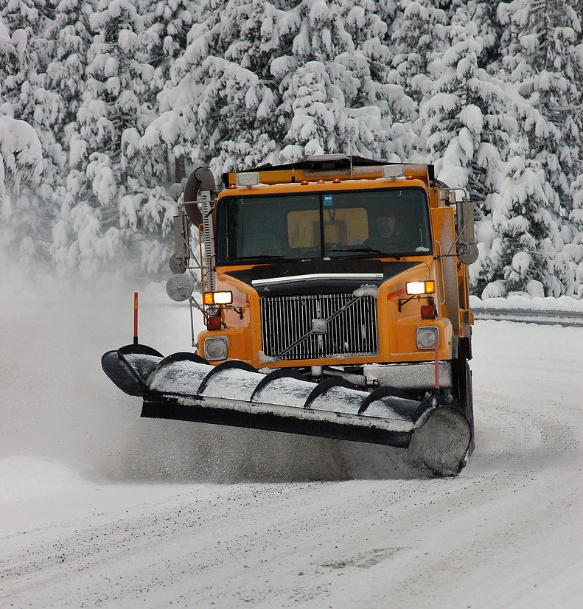
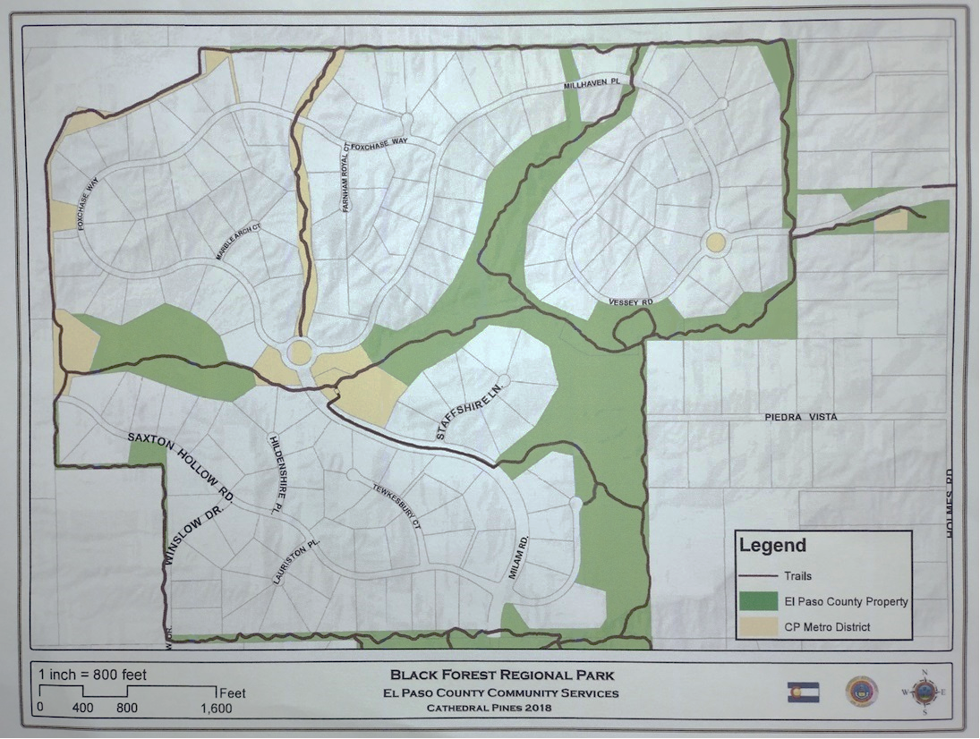
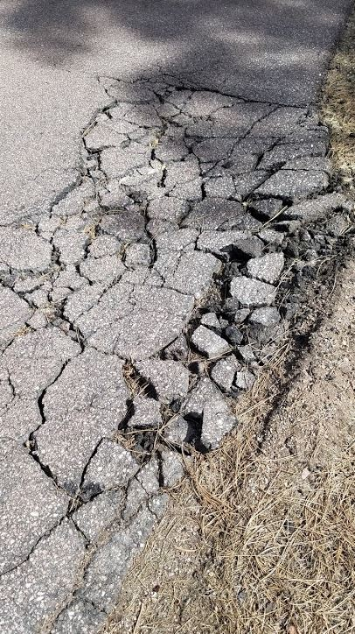
Who Does What?
El Paso County is responsible for:
Roads – Repairs and Maintenance
Curbs/Gutters- Repairs and Maintenance
Trail System Repairs and Maintenance on County Property (in conjunction with Metro District)
Weed Control Along Right of Ways
Drainage Along Right of Ways
Snow Removal on CP roads
Weed Control on County Properties
citizenconnect.elpasoco.com

Slide 10
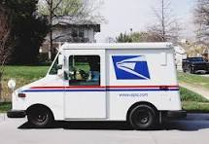
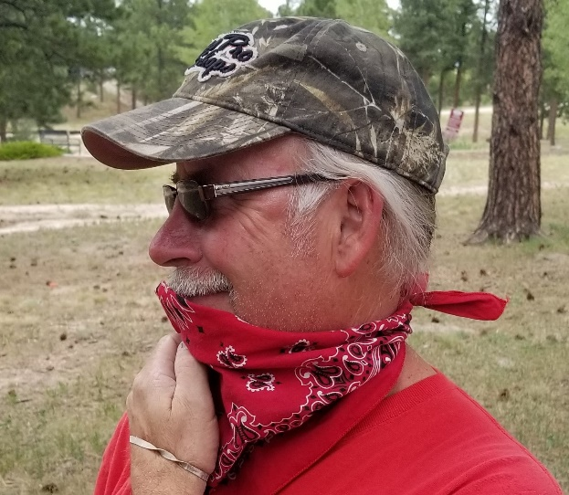
Who Does What? United States Postal Service provides:
Delivery of Mail to our individual mail kiosk boxes
Delivery of parcels that do not fit in parcel lockers to homes within six blocks of kiosk
If home is outside six block radius, packages must be picked up at Briargate Post office
Management of locks for mail lockers
Security of mail kiosk building is responsibility of community/Metro District (more on this later)

Slide 11
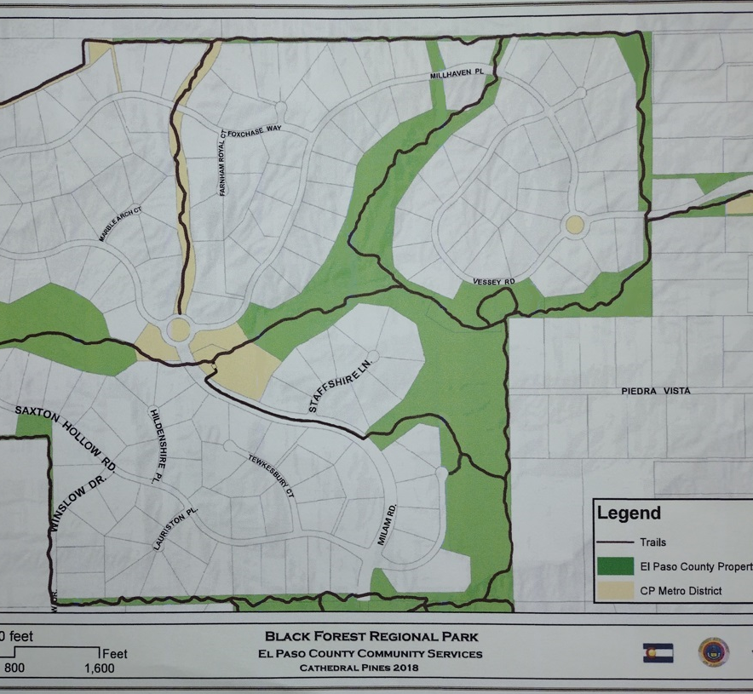
2023 Metro District Accomplishments
Trails and Maintenance
Pond liner repaired and shoreline rebuilt on lower pond
Cleared a channel for water into the lower pond
Cleared the cattails and dirt from the north water features
Restoration of native vegetation north of Vessey
New connecting path in the Milam median
Removed dead trees
Re-routed trail between Lodge and Mail kiosk
Repaired erosion damage to trails*

Slide 12
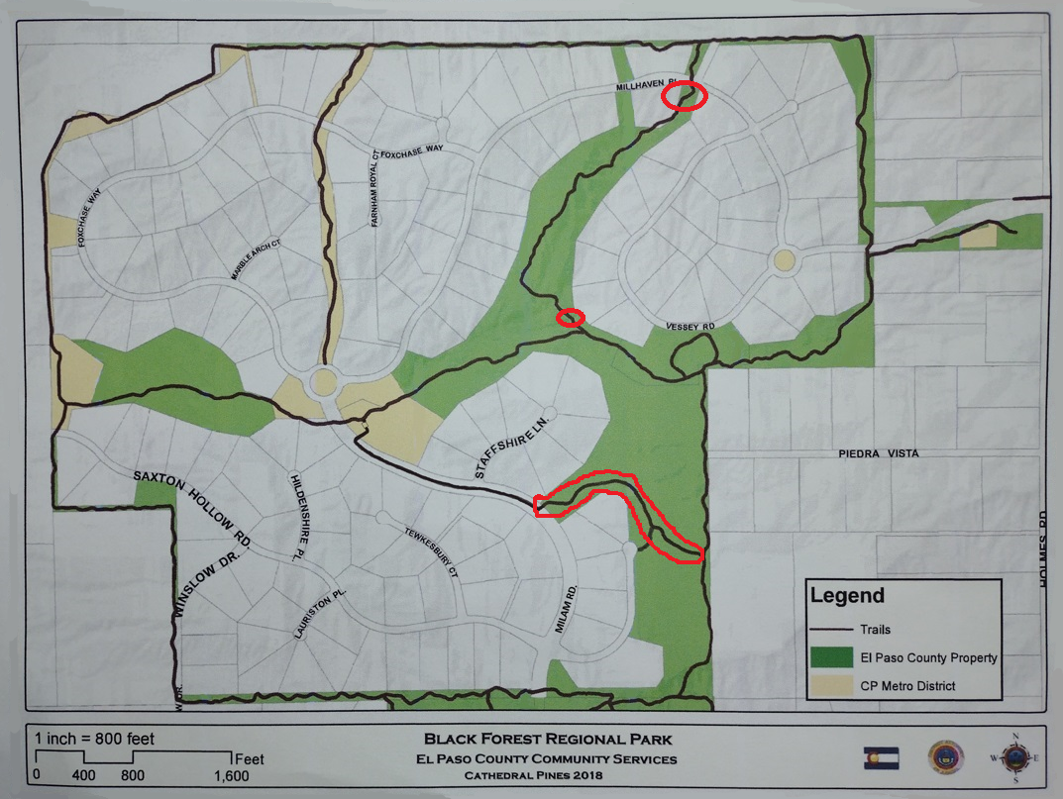
2024 Metro District Objectives
Trails and Maintenance
Erosion repair and re-routing the trail south of the Millhaven island
Remove grass and widen trail from Milam to the perimeter trail
Bridge decking maintenance
Erosion and weather maintenance
Remove dead trees

Slide 13
Thank you Ecton!

Slide 14
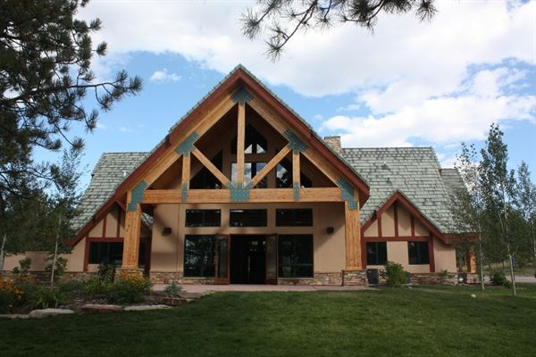
2023 Metro District Accomplishments
Lodge Operations
Hired new Lodge Manager in February 2023
Developed new marketing plan to reflect change in the manner in which venues are sought
Hired third-party consultant to improve online presence, including:
Redesign of website, including addition of video tour of facility
New emphasis on business-related bookings and End of Life Celebrations
Developed Google, Facebook outreach programs
Causes of bookings shortfall vs. budget;
Management change early in year
Transition out of COVID
Bookings take place year in advance
(result of 2023 bookings seen in 2024)
(continued)

Slide 15
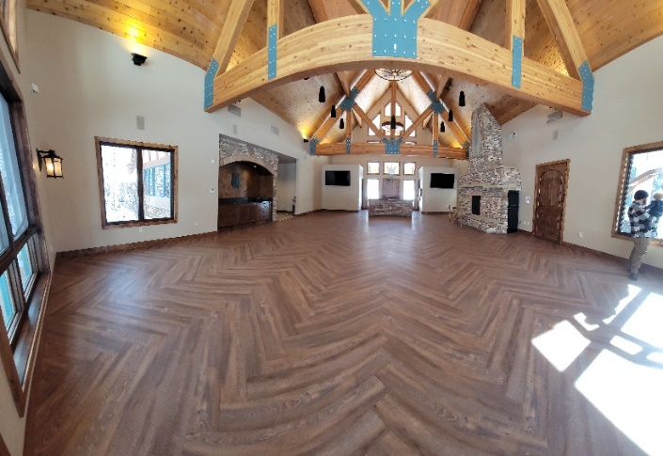
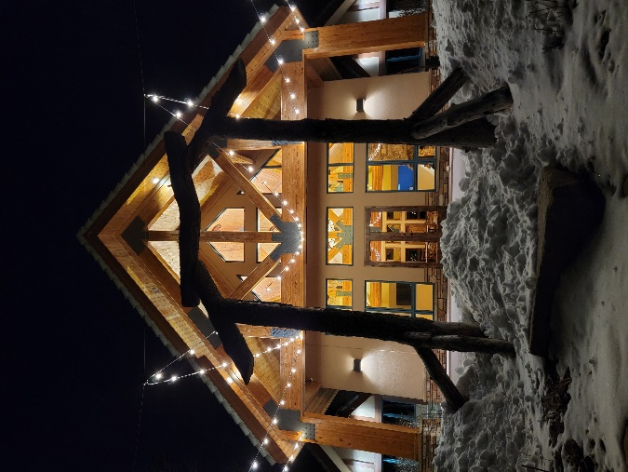
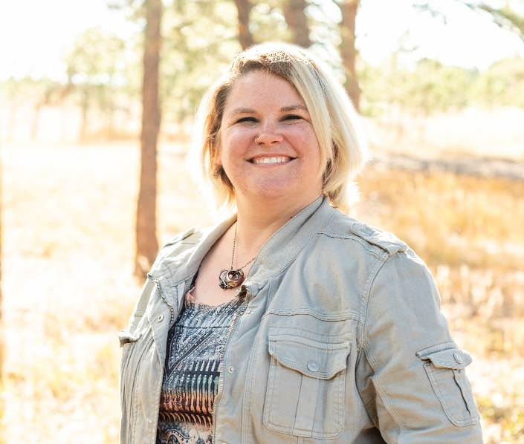
2023 Metro District Accomplishments
Lodge Improvements
Upgraded Mens and Womens Restrooms, including addition of Baby Changing Station
Replaced security and fire alarm systems
Installed outdoor audio system for patio ceremonies
Installed holiday lighting on Lodge exterior
Installed new energy-efficient, programmable thermostats
Replaced office furniture
Shalece Buchholtz
Lodge Manager

Slide 16
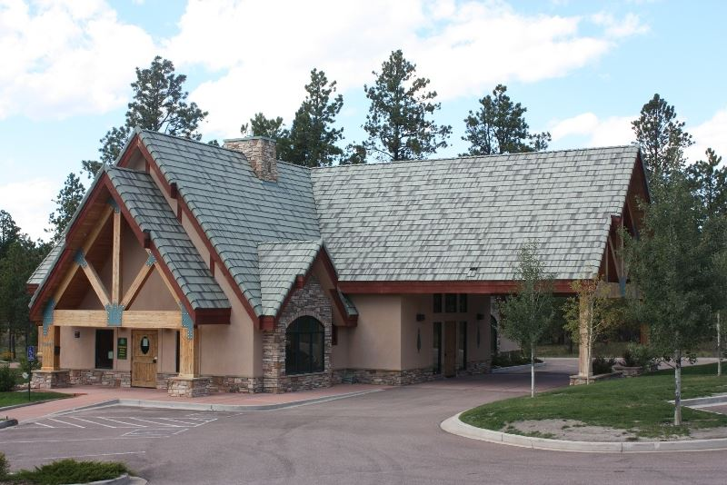
2023 Lodge Community Usage Recap
Metro Board Meetings
Support for HOA Events:
HOA Monthly Board Meetings
HOA Governance Meetings
HOA/ACC Board Meetings
Joint Comm. Engagement Committee Meetings
HOA Men's Night
HOA Bunco
HOA Family Movie Night
Recycling Event
Easter Egg Hunt
Resident Private Events
Resident-Sponsored Community Events

Slide 17
2024 Metro District Objectives
Lodge
Restore revenue to pre-COVID levels!
Develop additional Marketing programs to attract business off-site meetings, holiday parties and End of Life celebrations
Continue to improve outreach programs via social media
Replace seating!
Improve area used for outdoor ceremonies

Slide 18
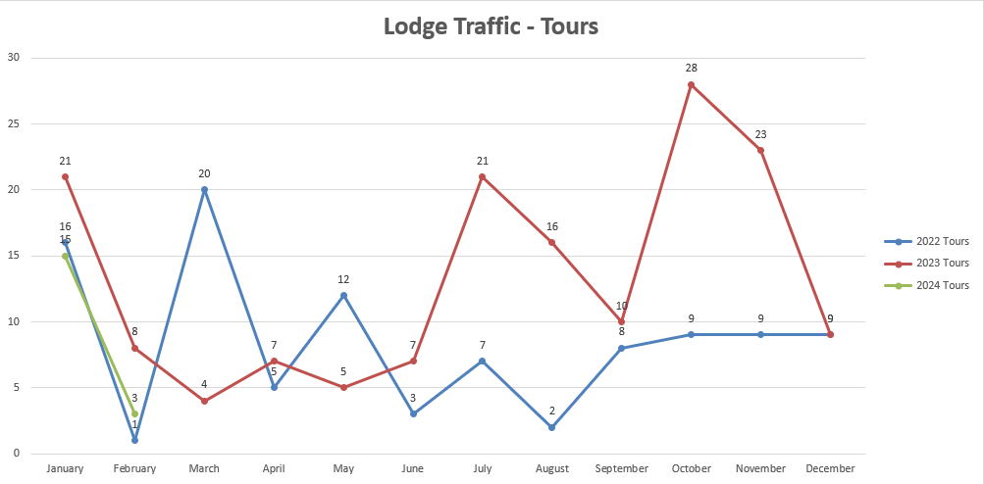
2024 Lodge Bookings Update

Slide 19
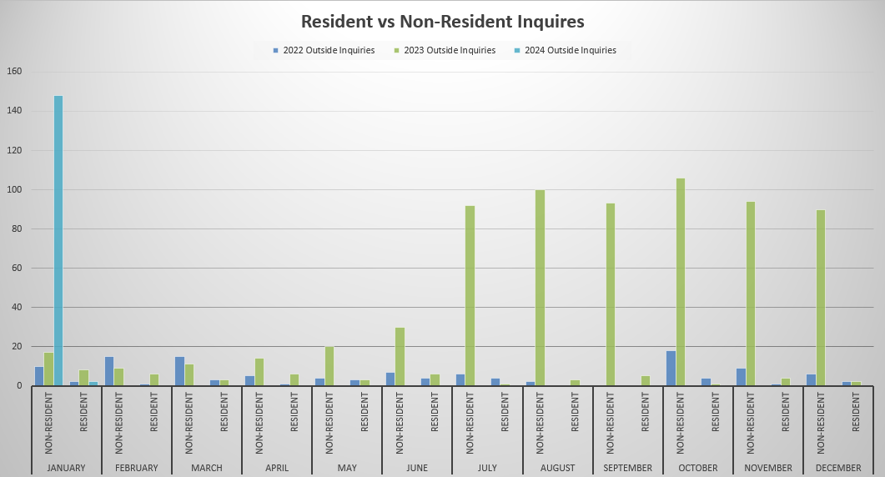
2024 Lodge Bookings Update

Slide 20
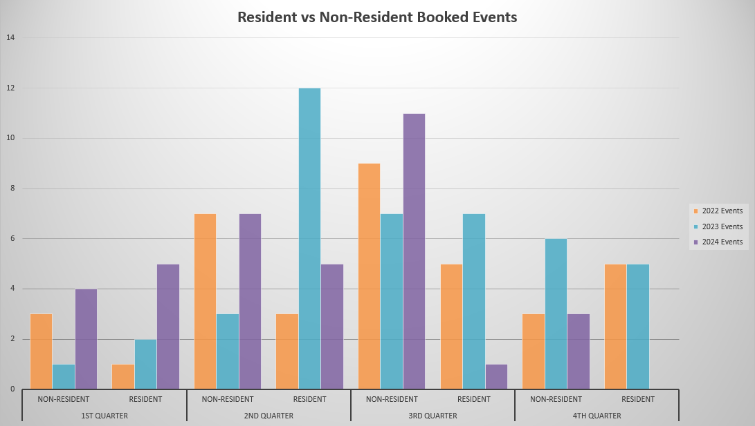
2024 Lodge Bookings Update

Slide 21
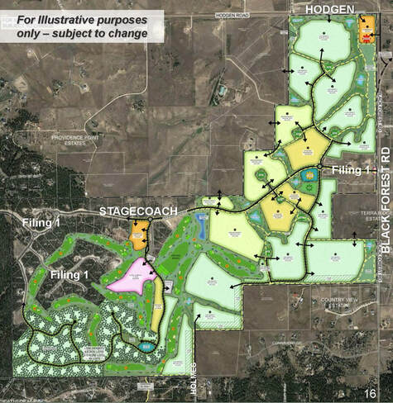
2023 Metro District Accomplishments
Nearby Community Issues
Flying Horse North
Attend numerous county meetings (Planning Commission and Board of County Commissioners) to oppose the development as currently planned.
Despite compelling arguments, failed to dissuade BoCC approving plans
Estates at Cathedral Pines
Villagree Custom Homes planned community along west side of Winslow
6 to 8 homes on 4 to 5 acres lots
Houses planned to be between $5M and $10M, within full landscaping packages
Will extend the perimeter trail to avoid walking on Winslow
Flying Horse North
Cathedral Pines Metropolitan District

Slide 22
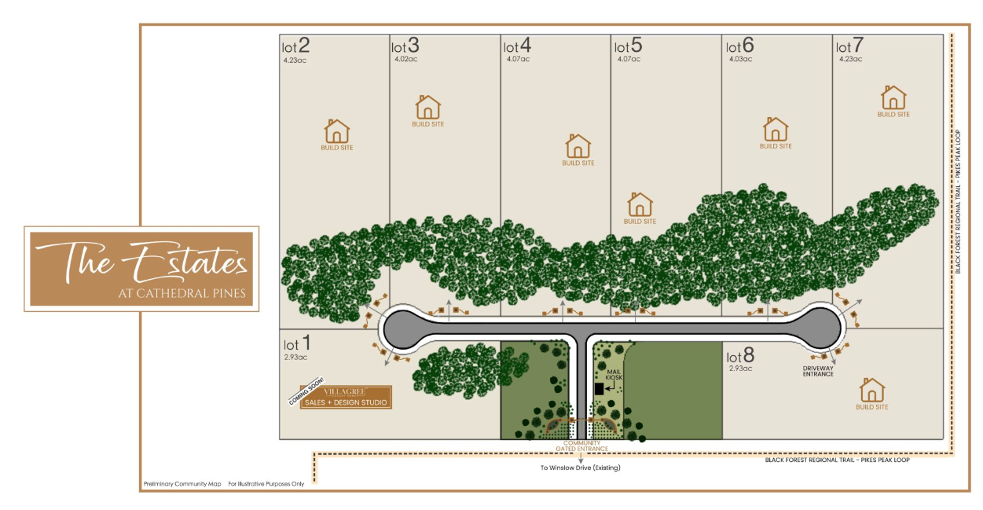
2024 Metro District Objectives
Flying Horse North
Will continue to monitor
No current plans to provide additional opposition as it’s clear the BoCC has already made up its mind to approve all future plans
Estates at Cathedral Pines
Construction should begin within the next few months

Slide 23
2023 Metro District Accomplishments
Financial Performance – Chris Meacham
Improvement in Financial Health since 2018
Strengthen Reserves for Contingencies
Collect remaining FEMA funds
Obtain $50,000 state grant for irrigation replacement
Improved bond rating and favorable audit

Slide 24
METRO DISTRICT TOTAL REVENUE & RESERVES - 2024 Projections
Property Tax - Average per Site | 4,069
Number of Sites | 172
Total Revenue | 699,785
Bond – Tax Revenue Dedicated to Interest, Principal & Other Debt Costs | 308,835
Property Tax Revenue less Bond Payments | 390,949
Lodge Rental | 78,000
Shed Rental | 12,000
Revenue Remaining for Operations | 480,949
General Fund – Beginning Cash Balance | 27,400
Remaining Amount for District Spending & Reserves in 2024 | 508,349
*Unaudited Financials

Slide 25
*Unaudited Financials
BOND ISSUED FOR CATHEDRAL PINES INFRUSTRUCTURE | 2022 Actual | 2023 Actual | 2024 Budget
Bond Payable | 4,627,284 | 4,552,284 | 4,467,284
Principal Payment | 75,000 | 75,000 | 85,000
Interest Expense (4.6%) | 216,350 | 213,350 | 210,350
Other Debt Related Expenses | 4,798 | 4,723 | 5,433
Total Annual Debt Financing | 296,148 | 293,073 | 300,783

Slide 26
*Unaudited Financials
REVENUE FLUCTUATIONS | 2022 Actual | 2023 Actual | 2024 Budget | 2023 Act to 2024 Bud | Comments
Property Taxes & Special Ownership Taxes | 354,069 | 343,616 | 390,949 | 14% | Increased Values
Lodge Rental | 68,077 | 61,131 | 78,000 | 28% | Conservative bookings
Grant Income - FEMA Funds | - | 50,000 | - | - | No Receipt in 2024
Other Income | 13,897 | 15,491 | 12,000 | -23% | $5k grant in 2023
Total Revenue | 436,043 | 470,238 | 480,949 | 2% | Minor increase

Slide 27
*Unaudited Financials
 | 2022 Actual | 2023 Actual | 2024 Budget | % Change
 |  |  |  | 2023 to 2024 Bud
Total Revenue + Grants | 436,043 | 470,238 | 480,949 | 2%
Professional Services | 92,421 | 95,764 | 108,600 | 13%
Lodge Operations | 143,042 | 117,878 | 123,500 | 5%
General Expenses | 183,406 | 368,903 | 173,800 | -53%
Other | 17,822 | 18,896 | 19,178 | 1%
Total Metro Expense | 436,691 | 601,441 | 425,078 | -29%
Net Income (Increase in Fund Monies) | (648) | (131,203) | 55,871 | 143%

Slide 28
*Unaudited Financials
EXPENSE FLUCTUATIONS | 2022 Actual | 2023 Actual | 2024 Budget | Inc (Dec) 2023 to 2024 | Comments
SELECT EXPENSE ITEMS
Landscape Maintenance | 75,035 | 57,401 | 77,000 | 19,599 | Maintain newly landscaped Milam
WSDM – District Managers | 44,201 | 73,023 | 84,000 | 10,977 | Exit Warren Mgmt. & engage WSDM for daily mgmt. tasks
Repairs & Maintenance | 32,604 | 24,257 | 30,000 | 5,743 | Less repaired in 2023 than prior years, should expect additional costs
Election | 30,457 | 16,555 | 0 | (16,555) | No election in 2024

Slide 29
2024 Metro Board Financial Objectives
Financial Objectives
Monitor Lodge revenues vs. expenses closely
Maintain Mill Levy for 2024 – Approx. $700,000
Determine how to continue implementing long-term landscaping improvements without materially affecting cash contingencies and reserves
Determine how to finance improvement in Mail Kiosk security
Strengthen Reserve Funds

Slide 30
Long Term Strategic Issues for Our Community
Status of Irrigation System Update
101 Landscaping was awarded the contract to replace the previous sprinkler system and started work in late summer
Sod was removed from the middle half of the median to flatten it and prepare for re-landscaping
Trenching for the new water main and zone lines
Plumbing and sprinkler heads installed
Path installed, with gravel and mulch in the middle half of the median
Walker Schooler applied for a State grant to facilitate replacement. We received a $40,000 initial grant and a $10,000 second round grant.
Sprinkler controller is scheduled to be installed late April

Slide 31
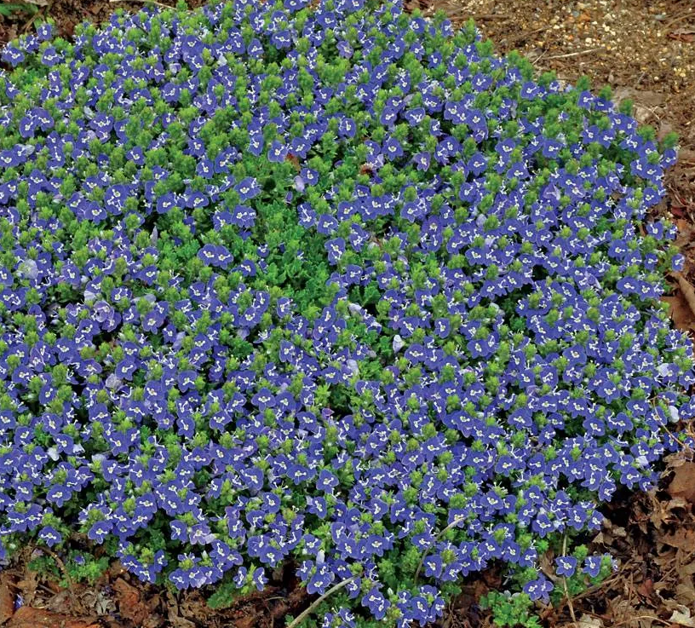
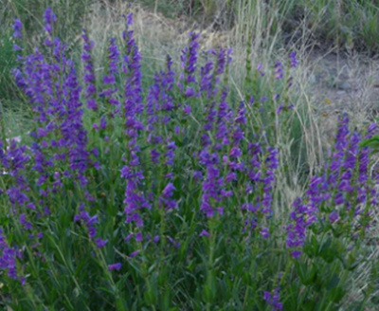
Status of Irrigation System Update/ Landscaping
2024 Plans for Milam median
Sprinkler controller installation, testing, and programming
Installation and planting in green plots and accents/focal points
Overseeding the remaining sod with fescue to reduce water use
Repair road asphalt where pipe trenches were cut

Slide 32
Long Term Strategic Issues for Our Community
Continued Vandalism of Mailboxes
Vandals have repeatedly broken into mailboxes and stolen parcels from lockers
Last September, thief stole master key to ALL mail kiosks in Colorado Springs
In December USPS agreed to replace all locks in kiosks with new technology, beginning in 2024
Cathedral Pines not due to receive new locks until May/June 2024
Efforts by Metro to deter vandalism have proven ineffective or not cost-effective

Slide 33
Long Term Strategic Issues for Our Community
Possible Solutions
#1 Install Decorative Security Gate around Mail Kiosk controlling access
Concept: Construct gate around kiosks and issue access codes, key cards, or fobs to residents for access
Residents would receive an access mechanism to retrieve mail and packages; those without access could not
Cost would be bourn by Metro District (Board has solicited cost and awaiting proposals)

Slide 34
Long Term Strategic Issues for Our Community
Possible solutions
#2 Relocate mailboxes either adjacent to or inside Lodge
Concept: Install controlled area on south side of Lodge, offering controlled access and greater security
Residents would receive access mechanism to retrieve mail and packages; those without access could not
Cost would be bourn by Metro District (Board has solicited cost and awaiting proposals)

Slide 35
2024 Initiatives
Problem #1 – Too much #2 on trails!

Slide 36
2024 Initiatives
Initiative #1 – Too much #2 on trails!

Slide 37
Community Feedback on Proposed Initiatives
Initiative #1 Installation of 3-4 Dog Waste Stations along trail
Benefits:
Reduced animal excrement along trail
Reduced number of dog litter bags left on trail
Dog Owner convenience of waste disposal
Initial purchase of stations projected $1,500 +/- for 4 stations
Maintenance of stations and disposal of waste (included in landscaping contract)
Replacement of bags (minimal)
Aesthetic impact

Slide 38
Community Feedback on Proposed Initiatives
Initiative #2 Installation of Memorial Benches along trail
Concept: Add 3-4 decorative metal benches along scenic points on trail
Residents would purchase bench with commemorative metal plaque dedication
Location based upon agreement with purchaser and Trails manager
Metro District would pay for installation
Cost to Homeowner: ~ $1,500

Slide 39
Conclusion
This Board’s goal is to make decisions that it feels are in the best interest of the community, based upon resident feedback, economic considerations, and additional research that guides those decisions
Are there areas of concern that you would like us to pursue that we are not?
Please sign up on our new Metro District e-mail list before leaving. You will receive our monthly newsletter, relevant Metro District announcements, and community surveys seeking your feedback
Thank you for attending!

Slide 40
Questions and Answers with our Homeowners

